Slide 1
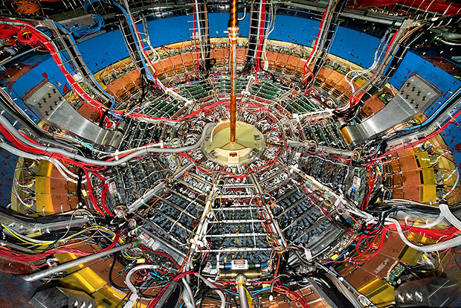
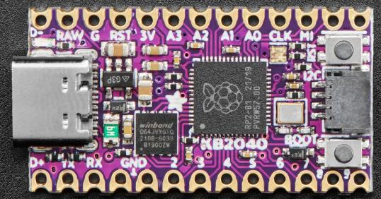
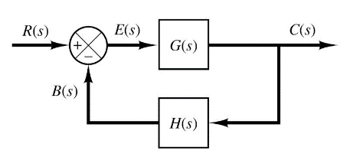

Control Systems
Engineering
(CSE 201)
Student #1
Student #2
Student #3
Team 06
Operational Amplifiers
Negative Feedback Loops

Slide 2
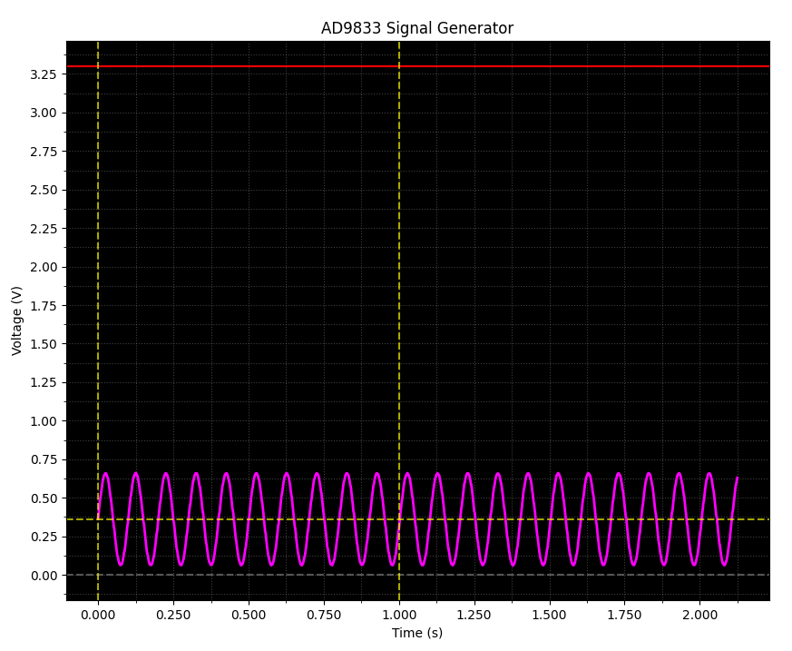
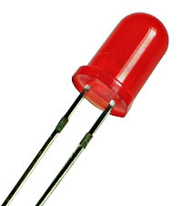
Our Challenge: Build a Signal Generator
A light emitting diode (LED) requires +2.0V to shine visible light, so we had to find a way to boost the output voltage of the AD9833 chip

Slide 3
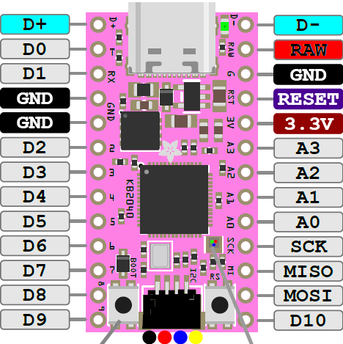
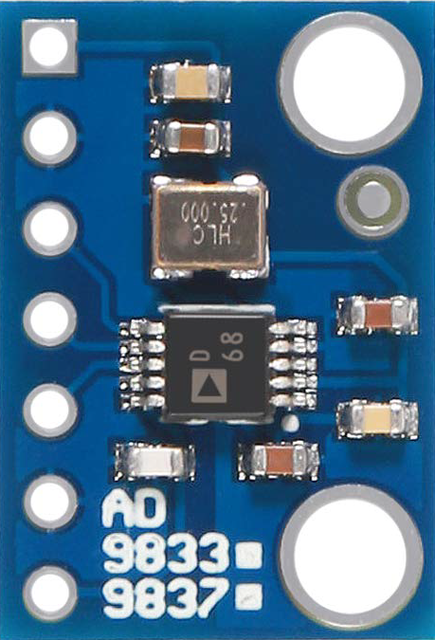
A Low-Power Oscillator
AD9833
V_{CC}
GND
SDATA
SCLK
FSYNC*
V_{OUT}
SDATA = Serial Data
SCLK = Serial Clock
FSYNC* → CS* (Chip Select)
MISO → POCI (Peripheral Out / Controller In)
MOSI → PICO (Peripheral In / Controller Out
GPIO Pin A0 will be set in ADC mode

Slide 4
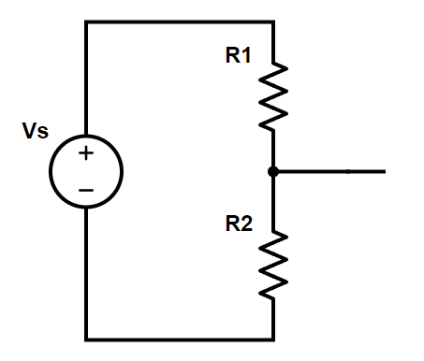











A Resistor-Network “Voltage Divider”
KVL
$$V_{s}=v_{1}+v_{2}$$
Ohms
$$v_{1}=i_{1}R_{1}$$
330Ω
+3.3V
Ohms
$$v_{2}=i_{2}R_{2}$$
$$i_{1}$$
+ ?? V
KCL
$$i_{1}=i_{2}$$
+ 2.83V
$$i_{2}$$
$$V_{s}=i_{2}\left(R_{1}+R_{2}\right)$$
$$i_{2}=\frac{v_{2}}{R_{2}}$$
2KΩ
$$V_{s}=\frac{v_{2}}{R_{2}}\left(R_{1}+R_{2}\right)$$
$$v_{2}=V_{s}\frac{R_{2}}{\left(R_{1}+R_{2}\right)}$$
$$v_{2}=\left(3.3\right)\frac{2000}{\left(330+2000\right)}=2.83V$$

Slide 5
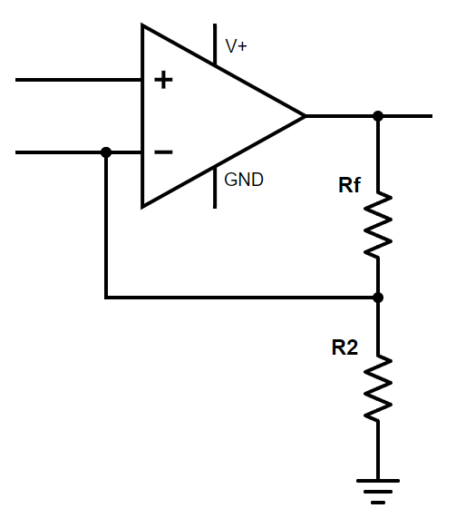

Operational Amplifiers
$$=0 V$$
An Op-Amp strives to zero the voltage difference between the two input pins if given a negative feedback loop
Here, we see a voltage divider placed on the Op-Amp output pin, with the middle tap routed back to the inverting input pin

Slide 6
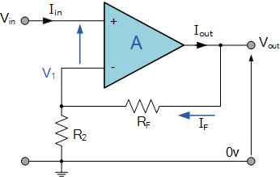
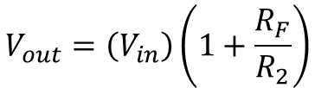





Operational Amplifiers
$$V_{1}=V_{in}$$
$$V_{1}=\left(V_{out}\right)\frac{R_{2}}{R_{2}+R_{F}}$$
$$V_{out}=I\left(R_{2}+R_{F} \right)$$
R_{F} and R₂ form a voltage divider
R_{F} is the "feedback" resistor
$$V_{in}=\left(V_{out}\right)\frac{R_{2}}{R_{2}+R_{F}}$$
$$V_{out}=\left(V_{in}\right)\frac{R_{2}+R_{F}}{R_{2}}$$
$$V_{out}=\left(V_{in}\right)\left(1+\frac{R_{F}}{R_{2}}\right)$$

Slide 7
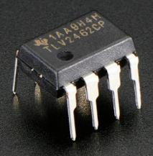

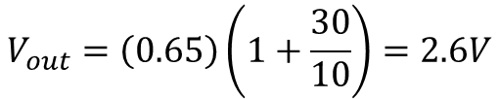
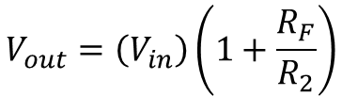
Operational Amplifiers
+3.3V
Our circuit generates a 4x gain on the input!
+0.65V
from the
AD9833
$$V_{in}$$
+2.6V ✓
30K Ω
$$V_{out}=\left(V_{in}\right)\left(1+\frac{R_{F}}{R_{2}}\right)$$
10K Ω
TLV2462 Op Amp
$$V_{out}=\left(0.65\right)\left(1+\frac{30}{10}\right)=2.6V$$

Slide 8
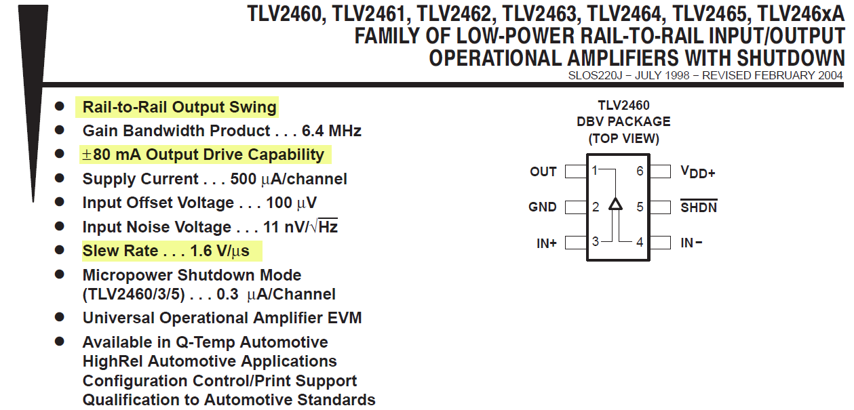
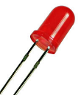
Consulting the Product Datasheet
https://www.ti.com/lit/gpn/tlv2462
✓
Pin Out
✓
rail
rail
✓
+2.0V
20mA
✓

Slide 9
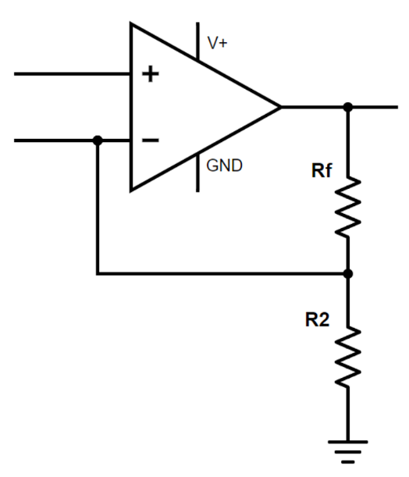
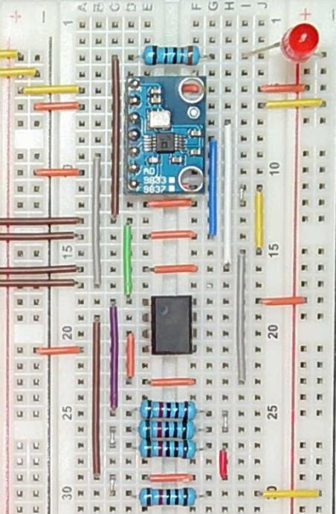
Mapping Logical ←→ Physical Layouts
The ability to map back-and-forth between a schematic and a circuit board is a skill that is in high demand!

Slide 10
Our Approach
code.py running on KB2040
op_amp.py running on Laptop
Waits for a serial (USB) port connection from the laptop
Connects to the KB2040 over the serial (USB) port
NeoPixel is GREEN
Waits for the command "r" to be sent by the laptop over the USB (CDC Data) port
Sends the string "r" to the KB2040 over the CDC Data port
Waits to receive the volts and time samples from the KB2040
Sets AD9833 to output a 10 Hz sine wave, sets NeoPixel to RED, records 2,000 volt and time samples FROM OP AMP
Plots the voltage vs. time graph from the OP AMP, along with the original sig_gen lab data, and creates a PNG file of the combined plot window
Sets NeoPixel to YELLOW as it sends the volts and times to the laptop over the USB port

Slide 11
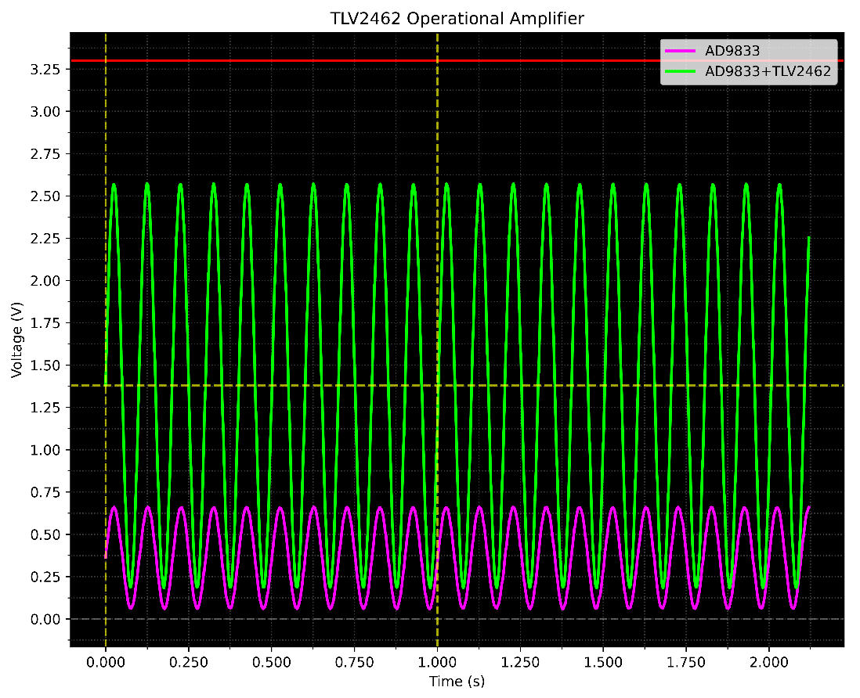
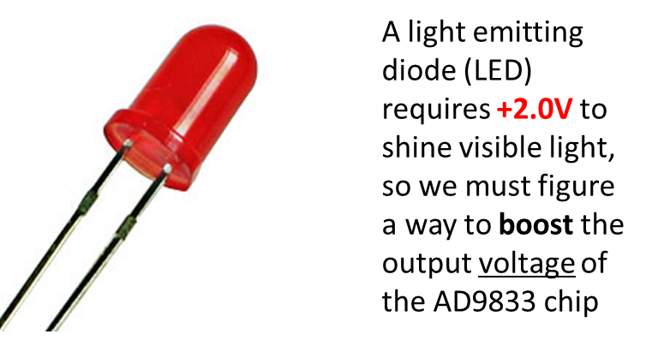
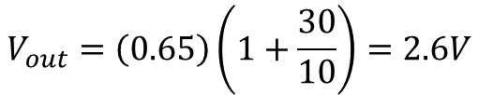
Our Result
$$V_{out}=\left(0.65\right)\left(1+\frac{30}{10}\right)=2.6V$$
We increased the offset by 4x
(avg. value)

Slide 12
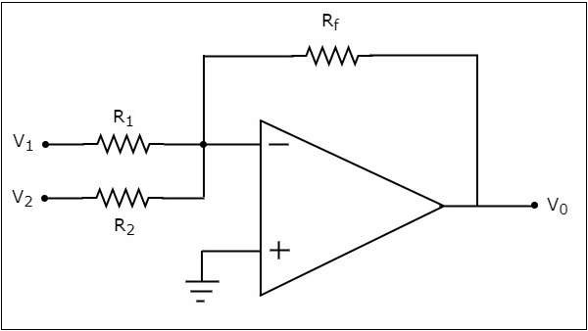
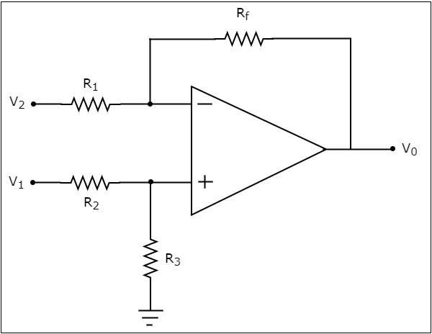
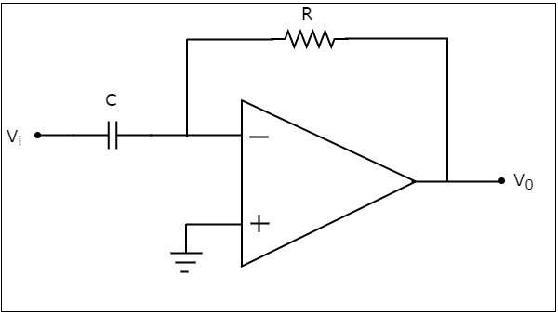
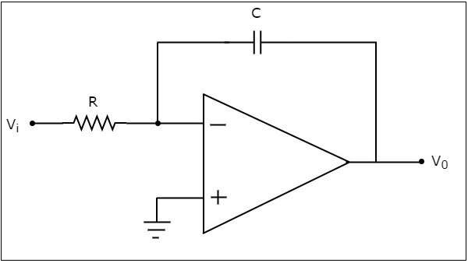
Operational Amplifiers
"Adder"
"Subtractor"
"Differentiator"
"Integrator"

Slide 13
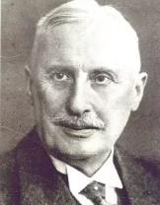
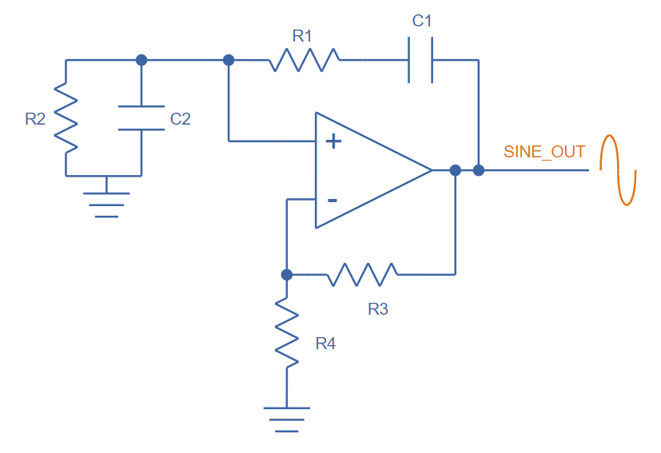

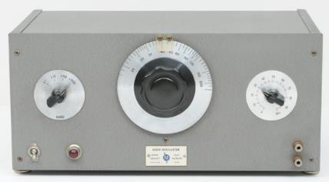
Operational Amplifiers
Wien Bridge Oscillator (1891)
Max Wien
1866-1938
Bill Hewlett & David Packard
HP 200A (1939)
https://en.wikipedia.org/wiki/Fantasound
(1940)

Slide 14
Team 06 – What We Learned
How to generate sine waves using a signal generator chip communicating with the MCU using the SPI bus
How to increase the voltage of a circuit using an operational amplifier (op-amp)
How to light an LED in a circuit by exceeding its bias voltage and prevent burn-out by using a current-limiting resistor
How to consult product datasheets to design a circuit to meet functional requirements
How an op-amp circuit can be wired to perform mathematical operations such as differentiation and integration

